Slide 1
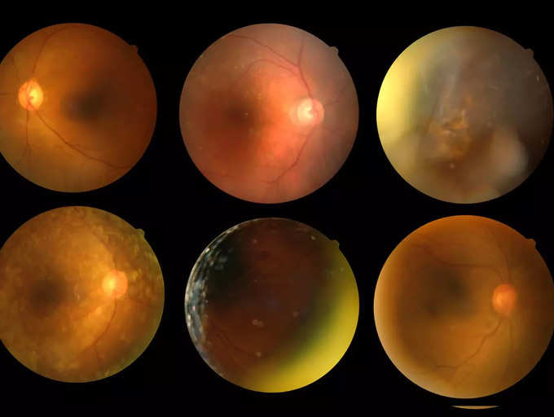
DEEP LEARNING FUNDUS IMAGE ANALYSIS FOR EARLY DETECTION OF DIABETIC RETINOPATHY

Slide 2
TEAM MEMBERS
P.K.Divyashree -814319104006
K.S.Gayathri -814319104012
A.Abitha -814319104001
C.Dowmika -814319104007

Slide 3
AGENDA
Introduction
Literature Survey
Scope of the Project
Module Description
Timeline chart
References

Slide 4
ABSTRACT
This project describes automatic diabetic retinopathy using deep learning algorithm
Different types diabetic stages is recognized using convolution neural network.
deep learning system that identifies referable diabetic retinopathy comparably or better than presented in the previous studies, although we use only a small fraction of images (<1/4) in training but are aided with higher image resolutions.
We also provide novel results for five different screening and clinical grading systems for diabetic retinopathy and macular edema classification, including state-of-the-art results for accurately classifying images according to clinical five-grade diabetic retinopathy and for the first time for the four-grade diabetic macular edema scales.

Slide 5
INTRODUCTION
Recently Deep Learning framework have been employed in various fields to aid in the development of automated systems.
Medical field require the help of machine intelligence for diagnosis of various diseases and drug discovery

Slide 6
Contd..
Diabetic Retinopathy (DR) is an eye disease associated with long standing diabetes.
It occurs when diabetes damages the tiny blood vessels inside the retina, the light-sensitive tissue at the back of the eye

Slide 7
LITERATURE SURVEY
TITLE | AUTHOR | MERITS | DEMERITS
Hierarchical retinal blood vessel segmentation based on feature and ensemble learning. | G. Cao B. Wei Y. Zheng G. Yang S. Yang, Y. Yin | The model uses LeNet-5 architecture for feature extraction and it is then fed into random forest classifier for categorization of images. Accuracy as reported 96% | The dataset used has limited number of images captured from homogenous source. (200)
Deep Convolutional Neural Networks for Hyperspectral Image Classification | Wei Hu, Yangyu Huang,Li Wei,Fan Zhang,and Hengchao Li | It is modelled using five different layers ,it reduces the sharable parameters across the layer and provides nearly good accuracy than SVM.it can also be applied to heterogeneous image data. | Problem of overfitting is addressed.

Slide 8
TITLE | AUTHOR | METHODOLOGY USED | MERITS | DEMERITS
A contribution of image processing to the diagnosis of diabetic Retinopathy detection of exudates in color fundus images of the human retina | P. Massin A. Erginay T. Walter, J. Klein | Morphological image processing techniques are explicitly used to extract features prevalent in DR affected images. | The model reported sensitivity 82% and specificity 86%. | It works well only for homogeneous Image datasets.
Automated identification of different stages of diabetic retinopathy using digital fundus images. | Bhat P. S. Acharya U. R. Lim C. M. Nayak, J. and M Kagathi. | Binary Classification of Image Processing Techniques. | They extract three features and train them using neural network achieving sensitivity 90% and accuracy 90% | It works well only for homogeneous Image datasets.

Slide 9
EXISTING SYSTEM
Majority of the existing literature extract the blood vessels or detect the lesions separately and the tools and techniques used are also different that make the system design more complex.
The super-pixel classification-based approach is proposed by including features from super-pixel level, which significantly improves the disc and cup detection. However, it has a bias of underestimating large cups and overestimating small cups due -to the dominance of medium sized cups.
Cheng et al. proposed super-pixel classification-based approach by including features from super-pixel level, which significantly improves the optic disc and cup detection.

Slide 10
However, it has a bias of underestimating large cups and overestimating small cups due -to the dominance of medium sized cups used to train the model.
Very often, these methods rely on the contrast between the cup and the neuro-retinal rim to find the cup boundary for CDR computation and can be challenging to use effectively when the contrast is weak.
Assessment of raised intraocular pressure (IOP) is the method previously used to detect glaucoma.
In the previous work on “Classifying glaucoma with image-based features from fundus photographs”, the features are normally computed at the image-level and we use image features for a binary classification between glaucomatous and healthy subjects.

Slide 11
DISADVANTAGES
They do not take into consideration of the noise or the image normalization in the input retinal image.
These methods does not show high contrast image for the output image.
Manual assessment is subjective, time consuming and expensive.
Poor and Inaccurate segmentation results
All Optic disc like regions are misclassified since it is hard to distinguish from fragments of the vascular system or from certain eye feature.

Slide 12
PROPOSED SYSTEM EXPLANATION
The proposed system uses the ResNet Convolutional Neural Network to detect Glaucoma. Though there are various available techniques to detect Diabetic Retinopathy but nothing of such sort can be found for Glaucoma which gives such high accuracy.
CNN based algorithm with SVM based classifier is implemented for extract the more features of images.
CNNs, in contrast, scale very well with the number of object classes to detect because nearly all computation is shared between all object categories. The only class-specific computations are a reasonably small matrix-vector product and greedy non-maximum suppression.

Slide 13
CONVOLUTIONAL NEURAL NETWORK
Convolutional neural networks are the go-to model for many computer vision classification problems
A special kind of multi-layer neural networks.
Implicitly extract relevant features.
A feed-forward network that can extract topological properties from an image.
Like almost every other neural networks CNNs are trained with a version of the back-propagation algorithm.

Slide 14
It consists of mainly five layers,
Input layer
Convolution layer
Pooling layer.
Fully connected layer
Output layer

Slide 15
PROPOSED ADVANTAGES
Nearly Accurate Detection of Glaucoma compared to existing approaches.
The noise content present in the retinal image is removed properly
Segmentation results of Optic disc and Optic cup regions are better.
The input retinal image is properly classified as normal or moderate or severe based on CDR ratio.

Slide 16
MODULES
RGB To Gray Conversion
Image Preprocessing (Enhancement)
Optic disc Segmentation
Optic cup Segmentation
CDR Ratio

Slide 17
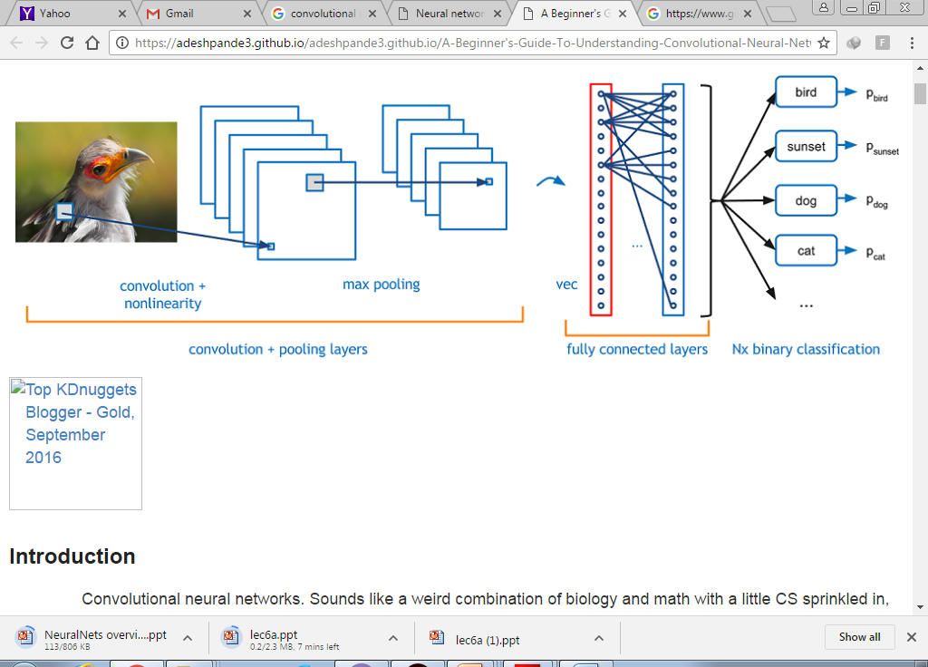

Slide 18
SCOPE OF THE PROJECT
First step is to employ the pre-trained convolution neural network called Alex-net for the purpose of classification.
Finally a CNN will be designed based on the analysis.
The model will be created and analyzed with the help of kaggle dataset.

Slide 19
ALEX-NET ARCHITECTURE
It utilized this model by loading the pre-trained weights, and only retrain the final fully connected layer to predict 5 classes rather than 1000.
This model effectively knows how to detect lines and edges, and need only learn how to use them to make predictions for our problem

Slide 20
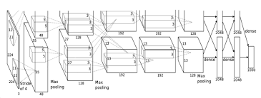
ALEX-NET ARCHITECTURE

Slide 21
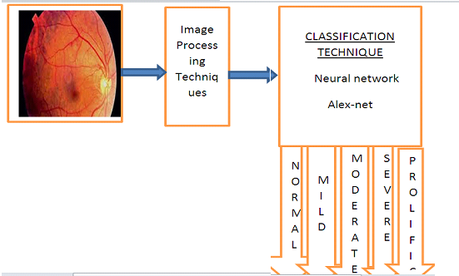
BLOCK DIAGRAM

Slide 22
MODULES FOR SYSTEM DEVELOPEMENT
MODULE 1:
-Setting up of environment.
MODULE 2:
-Analysis of dataset.
MODULE 3:
-Analysis of Alex-net model.
MODULE 4:
-Building a customized CNN.

Slide 23
SOFTWARE REQUIREMENTS
MATLAB Version R2017a

Slide 24
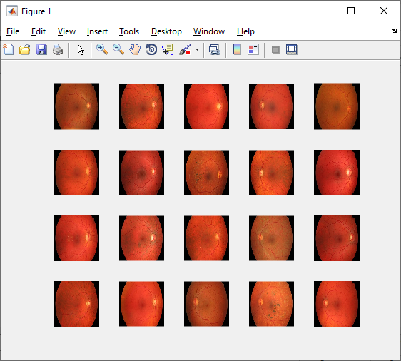
IMPLEMENTATION RESULTS

Slide 25
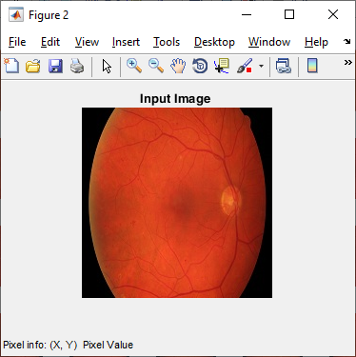
Input image

Slide 26
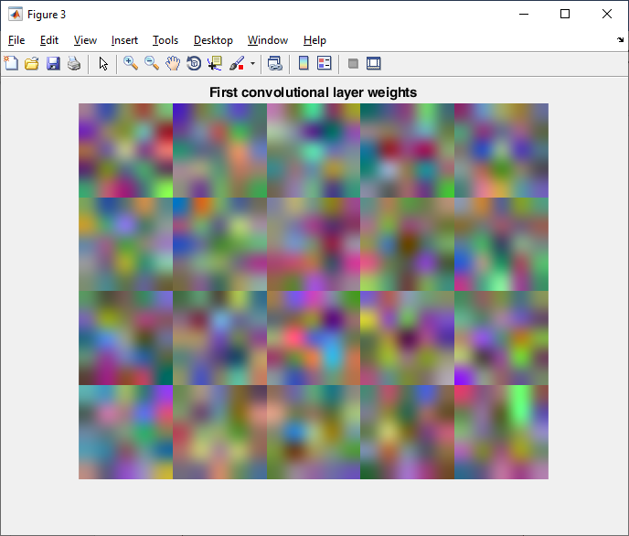
fully convolution weights

Slide 27
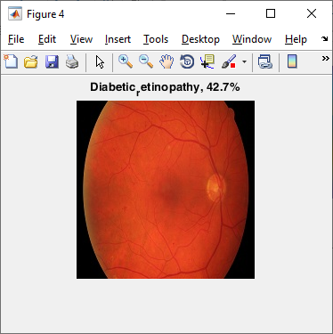
Diabetic retinopathy

Slide 28
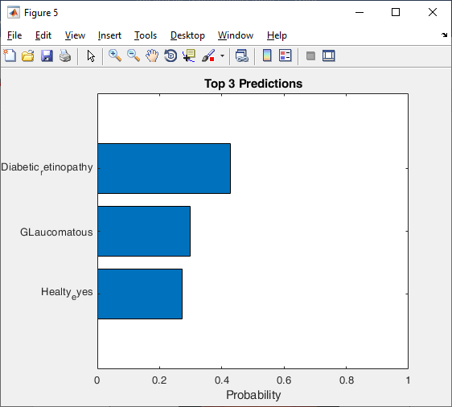

Slide 29
CONCLUSION
Glaucoma could be detected using the deep features highlighted by the visualized maps of pathological areas, based on the predicted attention maps. For training the AG-CNN model, we established the LAG database with 11,760 fundus images labeled as positive or negative glaucoma. A total of 5,824 images in our LAG database have the attention map on glaucoma detection obtained from 4 ophthalmologists. The experiment results show that the predicted attention maps improve the performance of glaucoma detection and pathological area localization in our AG-CNN method, far better than other state-of-the-art methods.

Slide 30
REFERENCES
[1] Marco Alban, Tanner Gilligan “Automated Detection of Diabetic Retinopathy using Fluorescein Angiography Photographs” Stanford University in 2016.
[2] Facts about diabetic eye disease. NIH National Eye Institute, 2014.
[3] Wei Hu, Yangyu Huang,Li Wei,Fan Zhang, and Hengchao Li “Deep Convolutional Neural Networks for Hyperspectral Image Classification” 22 January 2015

